Slide 1
Visualization of the Phylogenetic Tree
Metamap
Summer Undergraduate International Research Internships (SIRI)
University of Ottawa
Ruitian Gao
Notes:
Hello everyone, my name is Ruitian Gao.
I am honored to participate in the Summer Undergraduate International Research Internships .
Today I would like to present my project "MetaMap--the visualization of Phylogenetic Tree ".
1

Slide 2




Self-introduction
Education Experience
Shanghai Jiao Tong University
School of life sciences and biotechnology
2016 --- present undergraduate student
Major
bioinformatics
Notes:
To begin with, I will have a brief self-introduction.
I come from Shanghai Jiao Tong University, China. I am a sophomore in school of life sciences and biotechnology and my major is bioinformatics.

Slide 3
Content
1
2
3
4
Background
Methods
Results
Future development
Notes:
My presentation will cover the following aspects: background, methods, results and future development.

Slide 4
1
PART ONE
Background

Slide 5
Background
Liao et al. Bioinformatics (2018)
Notes:
My project is a part of iMetaLab. iMetaLab is a web based platform to provide a user-friendly and comprehensive metaproteomics data analysis pipeline. The whole process is submission, construct database, identification and quantification, taxonomy, functional annotations and report. My project focus on this part-- how to visualize results.

Slide 6
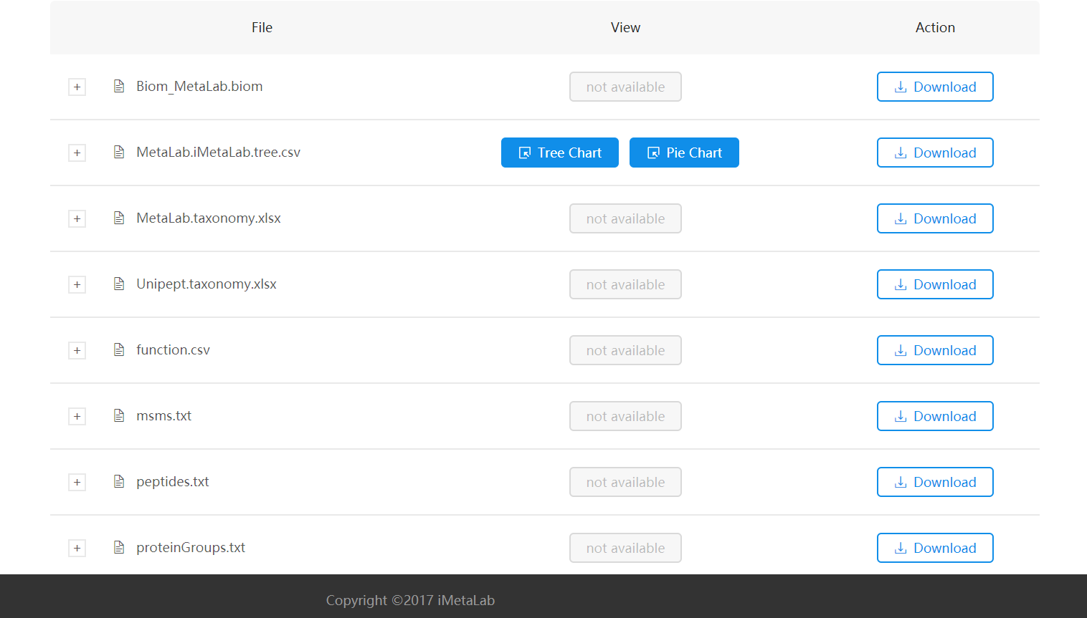
Background
Notes:
After users submit raw LC-MS/MS files, iMetaLab will analyse and output these files. What I did is visualizing the file called MetaLab.iMetaLab.tree.csv.
What the file looks like?

Slide 7
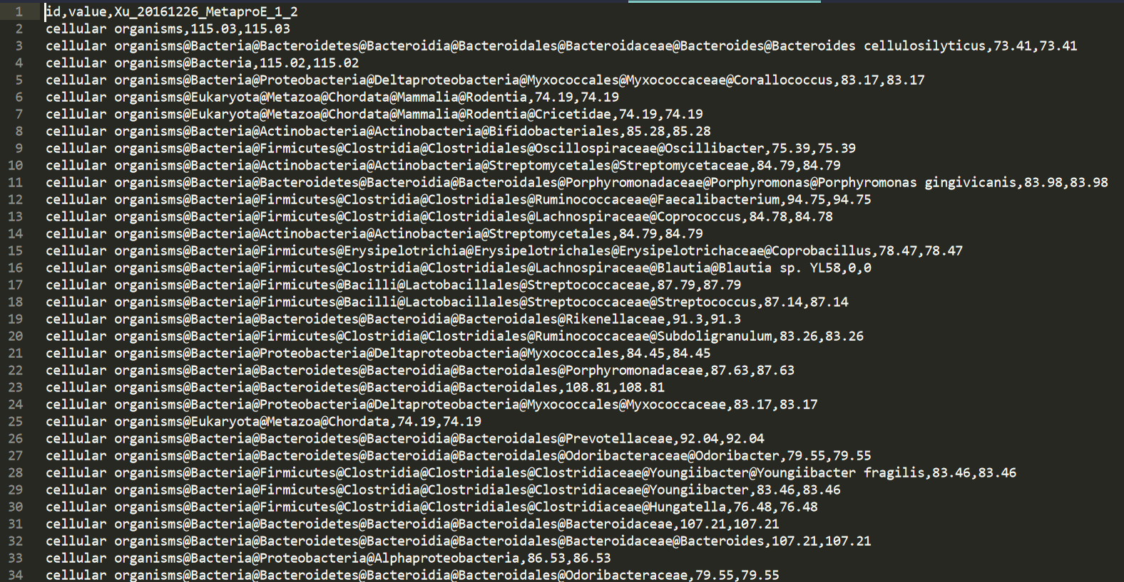
Background
MetaLab.iMetaLab.tree.csv
Notes:
It looks like this. Although the file involves many information such as the content and relative expression level in a microbiome sample and the relationship between different nodes, these big biological data are so abstract and eyes-confused. In this case, users cannot get enough useful information from it.
lowest common ancestor (LCA) terms:
-Kingdom
-Phylum
-Class
-Order
-Family
-Genus
-Species

Slide 8

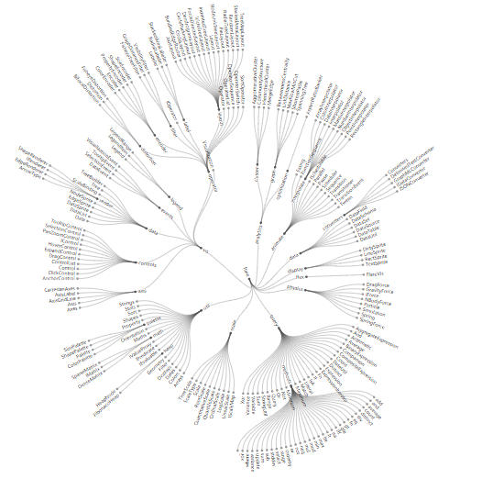
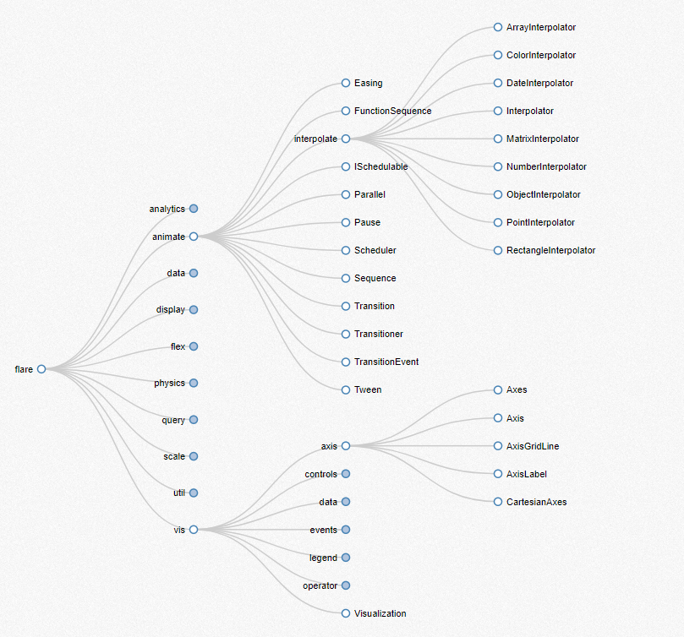
Aims and significance
DATA VISUALIZATION IN BIOLOGY
Notes:
In the age of big data, visualization can have a significant impact in biology.
Because of the way the human brain processes information, it is a good choice to visualize large amounts of complex data by charts or graphs.
For example, these graphs can show the relationship of different nodes clearly, it is a good way to visualize biological data.

Slide 9
2
PART TWO
Methods

Slide 10
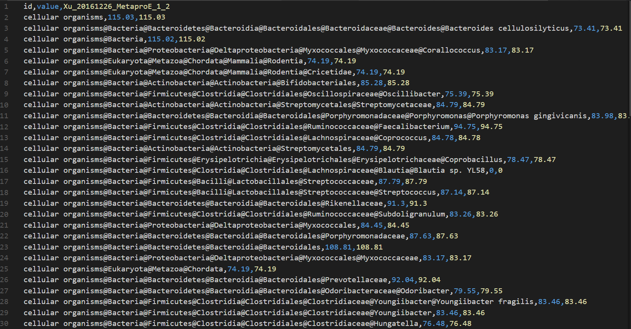
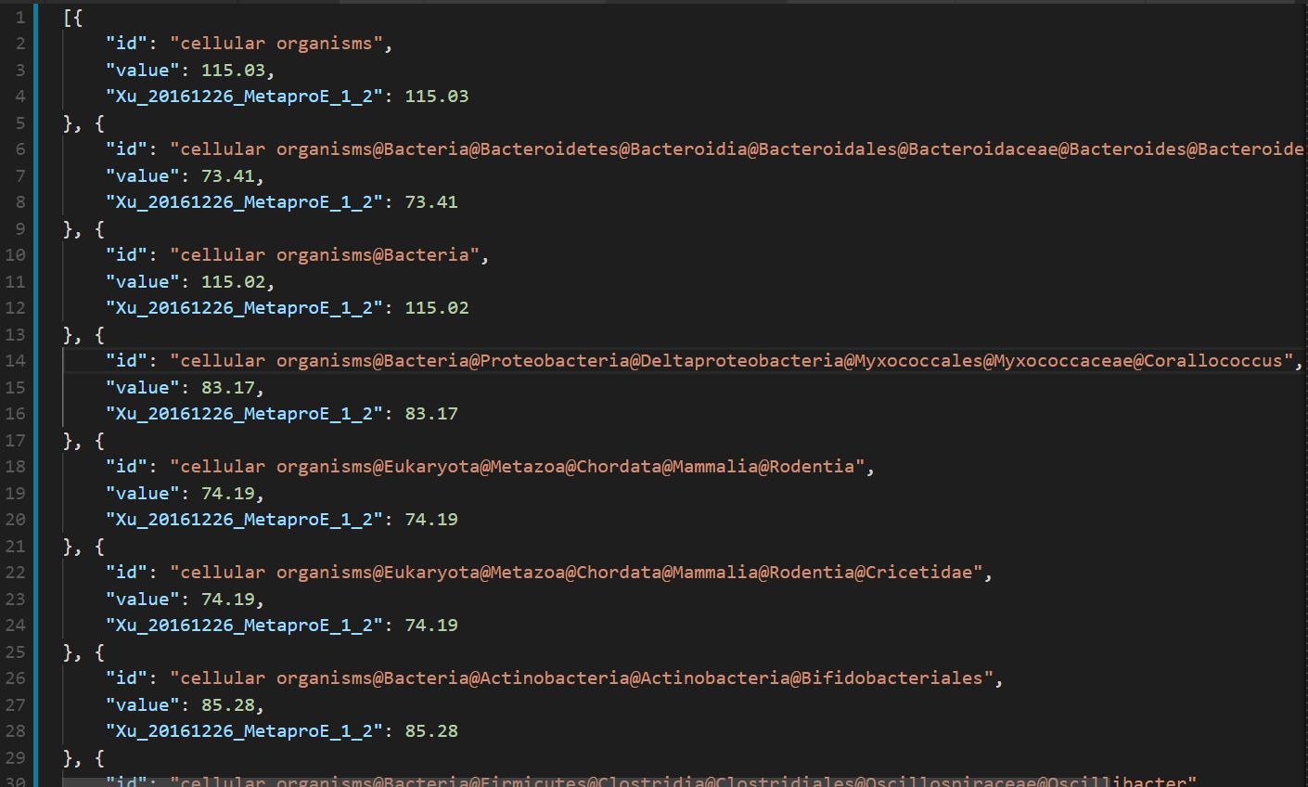

Methods
CSV file
JSON file
Python
Convert
Notes:
Our raw data are CSV files. However, the JSON is easier for computer to parse and generate and is an ideal data-interchange language.
So I use python to convert the csv file into json file.

Slide 11


Methods
Data Visualization
D3.js
SVG
Notes:
I use D3.js and SVG to make data visualization. D3.js is a javascript library to visualize data and SVG refers to scalable vector graphics.
However, I don't want to just make data into static graphs, I want to make them dynamic and can interact with users. So I need to build a website and make dynamic and interactive data visualization in web browsers.

Slide 12

Methods
HTML
HyperText Markup Language
CSS
Web programming
Cascading Style Sheets
A website
JavaScript
Enables interactive web page
Notes:
When it comes to building a website, there are three core technologies of the World Wide Web.
HTML is the standard markup language for creating web pages and web applications.
CSS is a language used for describing the HTML.
And Javascript enables interactive web pages and thus is an essential part of web applications.

Slide 13
3
PART THREE
Result

Slide 14
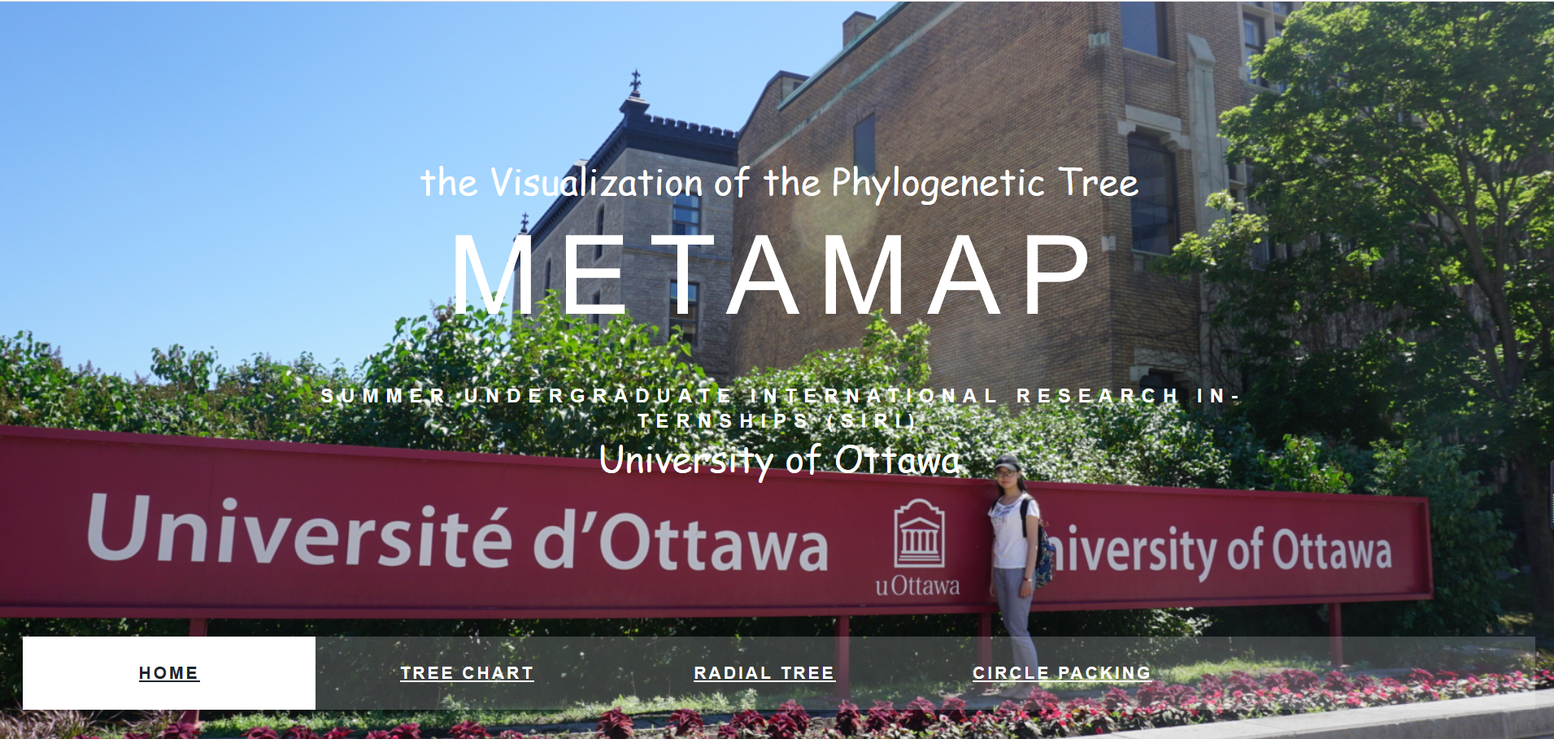
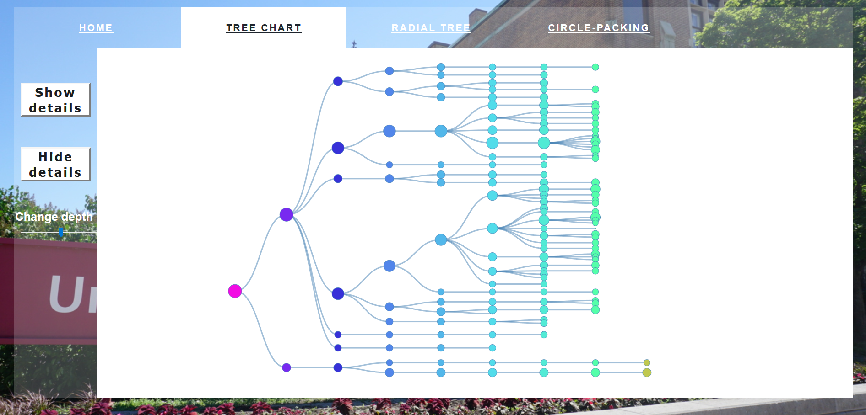
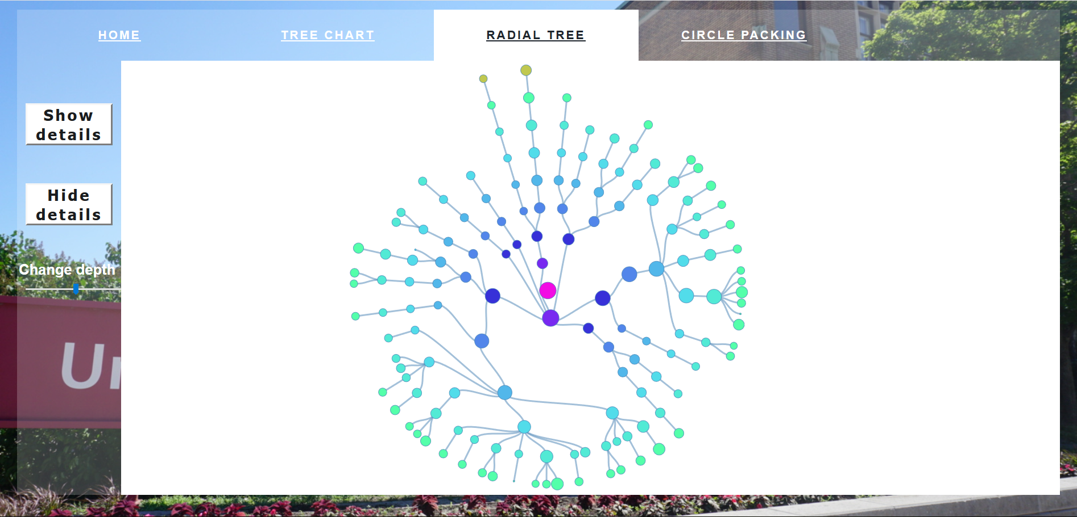
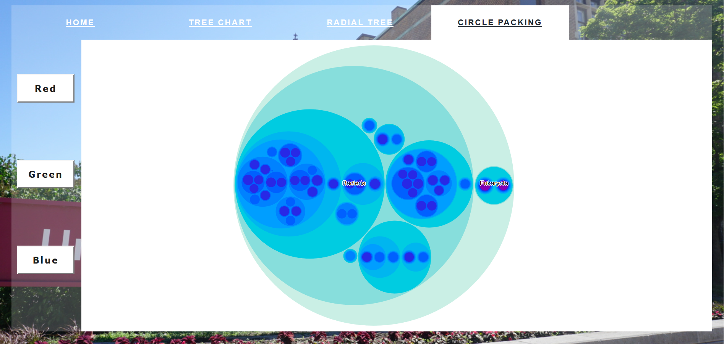
Result
https://ruitian-olivia.github.io/project_metamap/index.html#page-content

Slide 15
4
PART FOUR
Future development

Slide 16
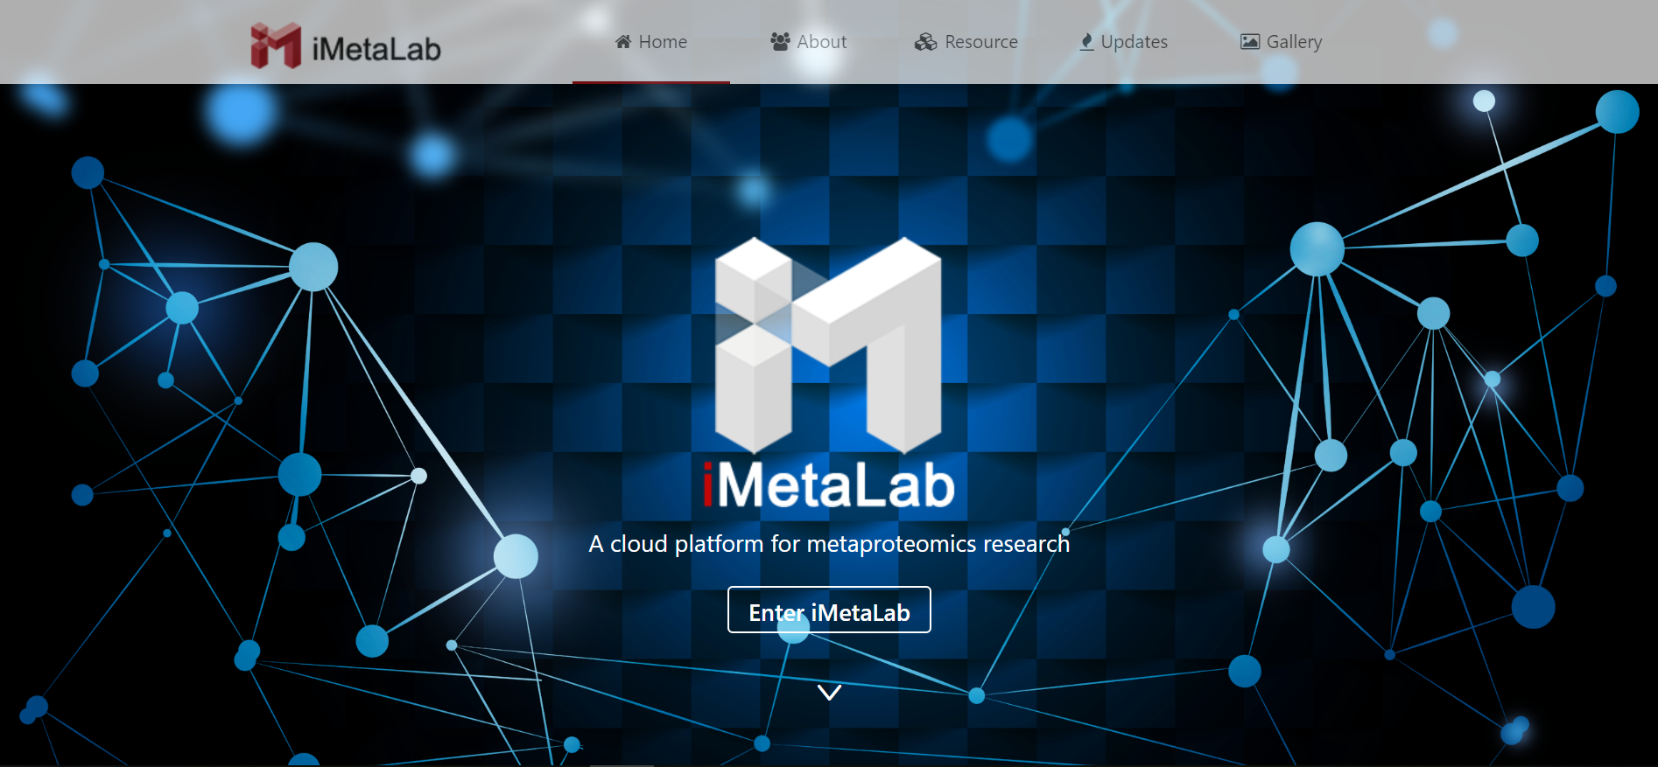
Future development
More user-friendly
Adding more features
Integrated into iMetaLab

Slide 17

Acknowledgements
Dr. Daniel Figeys
Dr. Zhibin Ning
Dr. Bo Liao
Dr. Kai Cheng
Dr. Leyuan Li
Dr. Janice Mayne
Dr. Shelley Deeke
Dr. Henghui Li
Dr. Rachid Daoud
Dr. Elias Abou Samra
Dr. Xu Zhang
Dr. Amanda Starr
Miss Lioudmila Tepliakova
Miss Krystal Walker

